Slide 1

Project on automatic birthday mail sending using python

Slide 2
OVERVIEW
Let’s open our favorite IDE and create a file named main.py. Now we need to install a few models which will help this program to run, such as pandas, openpyxl etc.
Now we will create an excel sheet on that folder and open it. We will add the following rows, such as Sno, Name, Birthday, Dialogue, Year, Email. Now for testing purposes we will add a few entries to it. Now let's get back to the main.py file. Now we need to create a function which will read the excel file and extract data from it. We will use the pandas library for it. Now to send email we will use the smtplib library. We will be using Gmail for this application. Now we need to create a function which will send email using a Gmail id. Now to use this service you need to enable less secure apps on the Gmail account which you are going to use for sending the messages

Slide 3
IDE Used
Jupyter Notebook
Py Charm
Vs code

Slide 4
IMPORT LIBRARIES
pandas
datetime
smtplib
time
requests
win10toast

Slide 5
PANDAS Pandas is an open-source library that is built on top of NumPy library. It is a Python package that offers various data structures and operations for manipulating numerical data and time series. It is mainly popular for importing and analyzing data much easier. Pandas is fast and it has high-performance & productivity for users.
WHY USE
We use pandas to read our excel file and fetch the data in our code with the help of pandas we do easily read and fetch the data i.e., its very important library in python and also useful in our code.

Slide 6
DATETIME In Python, date and time are not a data type of its own, but a module named datetime can be imported to work with the date as well as time. Datetime module comes built into Python, so there is no need to install it externally. Datetime module supplies classes to work with date and time. These classes provide a number of functions to deal with dates, times and time intervals.
WHY USE
To make this possible one thing is that we need to make sure that the email is sent only one time not more that one. for that we are just going to use the date-time module. using date-time we try to find our the current year and of the current year is equal to the year we put in our excel file then no email will be sent because we have already wished him, else an email is sent.

Slide 7
SMTBLIB Python, being a powerful language don’t need any external library to import and offers a native library to send emails- “SMTP lib”. “smtplib” creates a Simple Mail Transfer Protocol client session object which is used to send emails to any valid email id on the internet. Different websites use different port numbers.
WHY USE
We are using a Gmail account to send a mail. Port number used here is ‘587’. And if you want to send mail using a website other than Gmail, you need to get the corresponding information.
s=smtplib.SMTP(‘smtp.gmail.com’, 587)
For a connection between our Gmail & python script

Slide 8
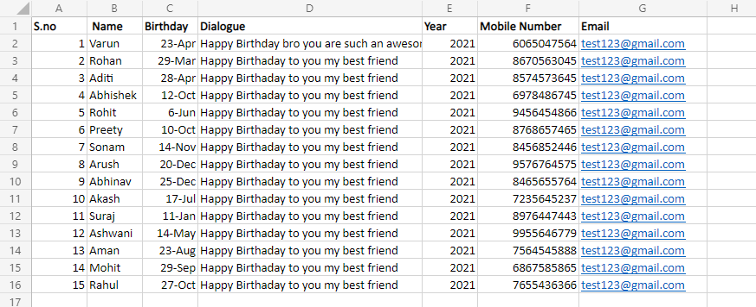
Create an Excel sheet for containing records like this: Name, Email, Contact, Birthday, and Year.

Slide 9
DESCRIPTION
Create an Excel file that contains the name, email, mobile number, message, year, Time.
Using pandas fetch birthday year and date.
Create a send_email function that can be used to send an email. it takes email, message, and subject as input.
If the birthday year is equal to the current year, then don’t send the email because it is already been sent.
If today is equal to a birthday day, then check for the current time is equal to the wish time, then send the email using the send_email function and increase the year column by one.
Using windows scheduler makes the program run at every day 12:01 am.

Slide 10
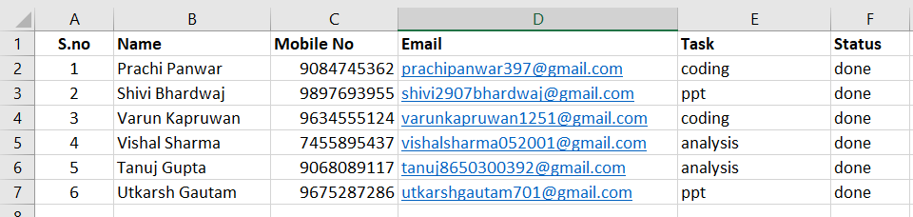
OUR SUPPORTING TEAM

